Slide 1

The Turquoise
Unleash your creativity with code.
Residential Project Singapore

Slide 2
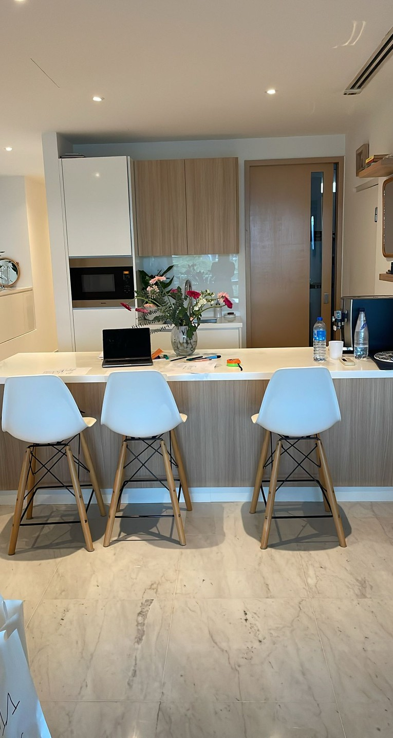
What is this project?
A web-based challenge to build creative apps.
Residential Apartment
Singapore
Scope of work
Living room, open kitchen & corridor 61 m2
Design fees
305 USD
webinar 14.11.2024 5:00pm CET ( Paris Time )

Slide 3
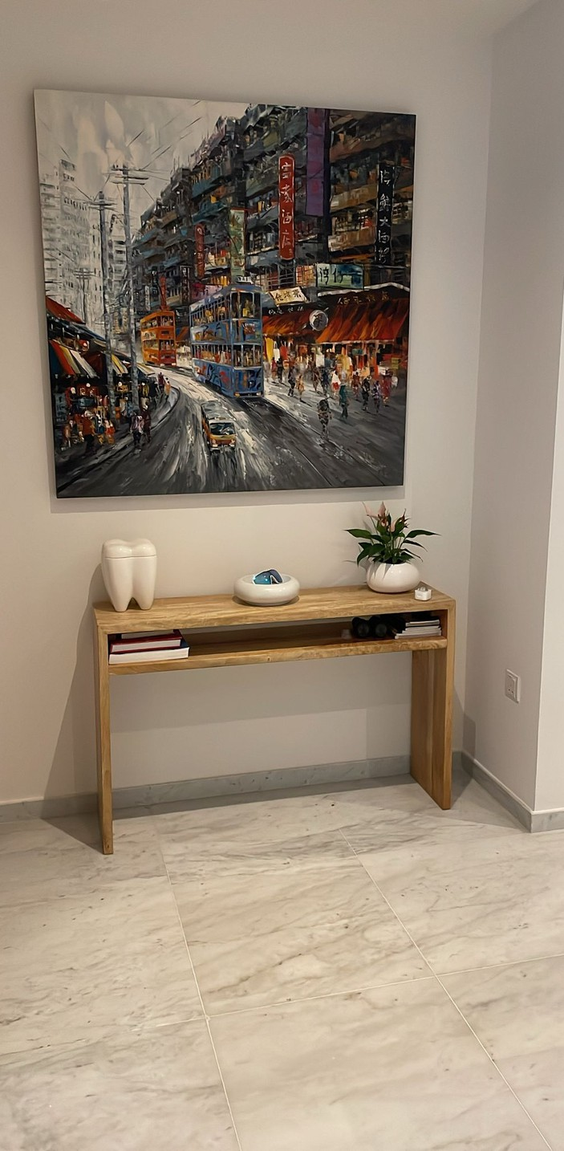
Why join?
Learn React, work in teams, and win prizes.
We moved in this apartment during co-vid so we couldn’t do renovations.
We want to change everything for a full re-vamp.
We want to have a design made with 2 options:
keeping the existing floor new flooring
The kitchen will be redone
All furniture & deco to be changed

Slide 4
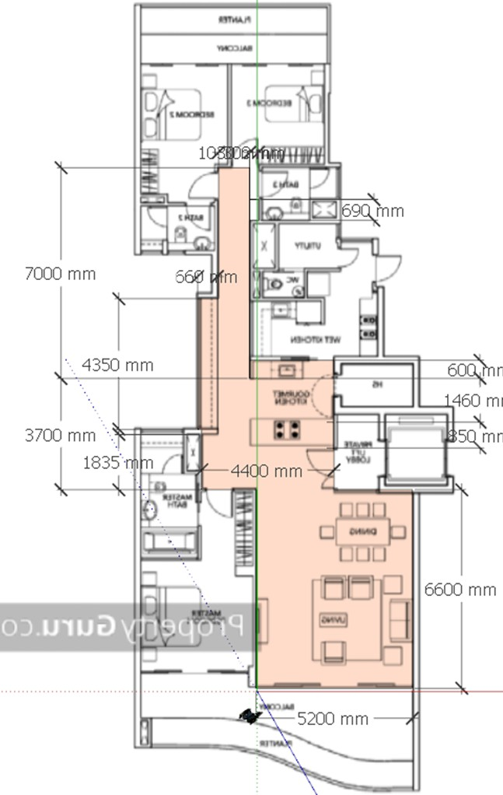
How to apply
Signup by April 5. Teams of 2-4. All juniors welcome.
in cm
Details of living room ceiling in the next slide
Ceiling height in kitchen and corridor 2600mm
Scope of areas:
Living room Dining Corridor
Refer to sketchup file & videos

Slide 5
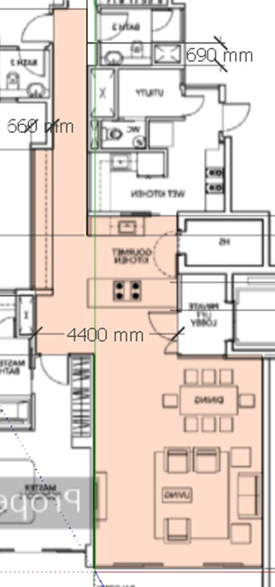
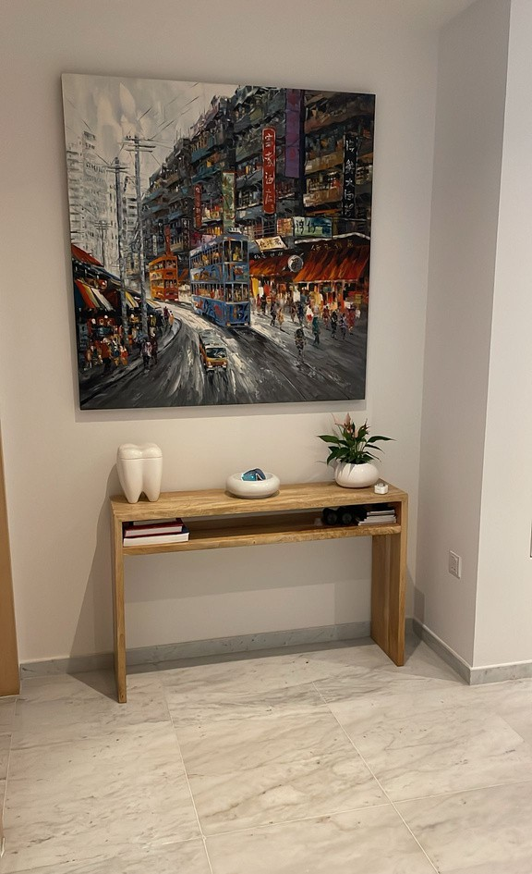
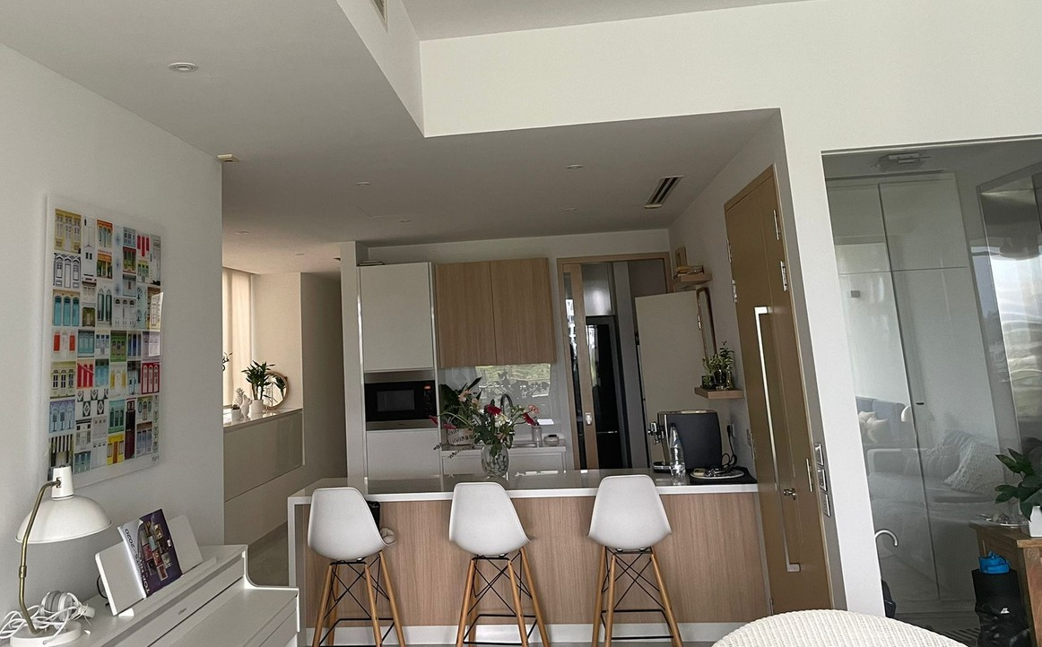
Contact
Reach us at hello@yourorg.com or click the link below.
1. This place is very important as it is facing the entrance door. What do you want to see - the woah effect when you come in? Be careful not to block the entrance of the master bedroom.
1
1
1
2
2

Slide 6
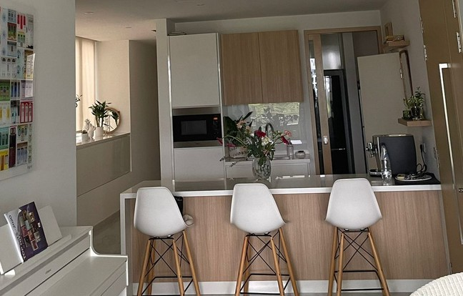
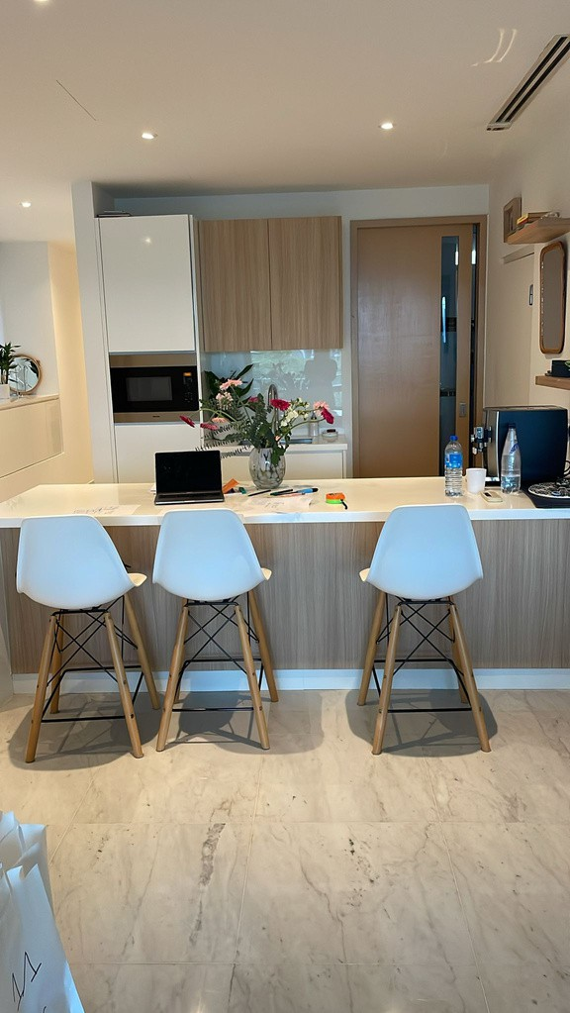
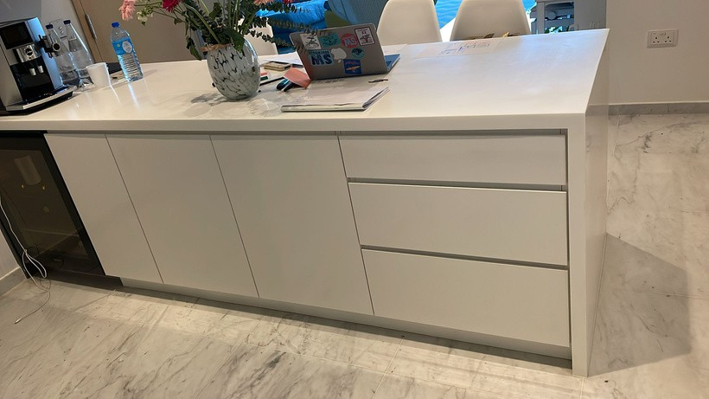
Photos
3
Counter today is 850mm depth - the client want to change it to a dining table for 6 to 8 pax - depth 1100mm - open below except on the wall side where you need to keep the wine fridge
width 600mm - HT to be 900 to 950mm with seat HT 650mm.
This is a dry kitchen - wet kitchen is behind. The microwave can be moved behind so you can have a low counter with a sink and relocate the coffee machine there - with top hung cabinets.
1
4
4
You can change the bar stools or keep them and add more pieces.
3

Slide 7
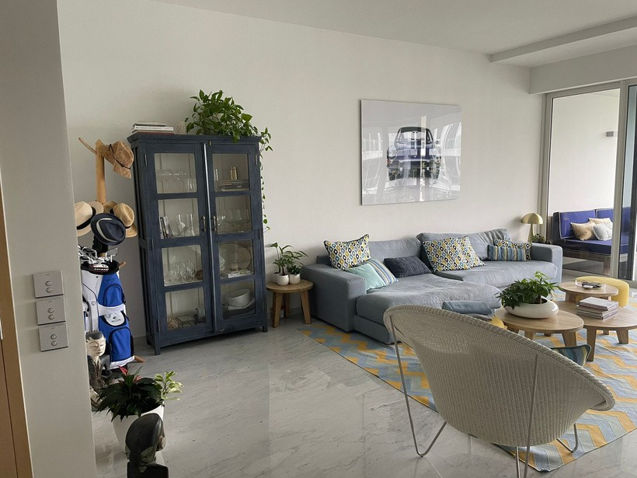
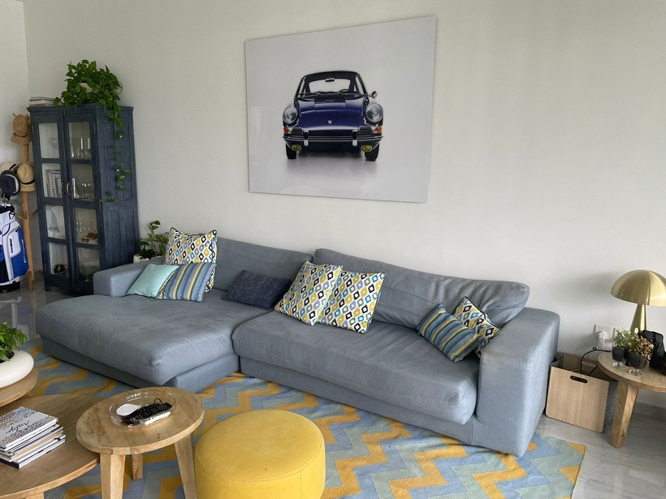
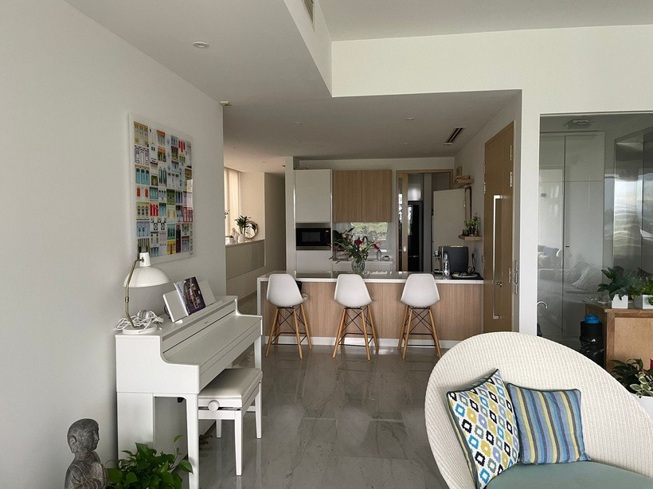
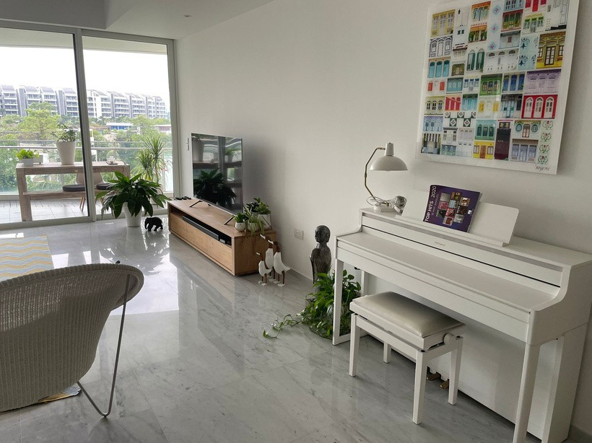
Photos
5
6
1
5
4
8
7
6
7
8
All the furniture can be changed. The client likes oversized sofa. The only she likes is the white armchair, but she is ok to change it if it doesn’t match the design overall concept.
The piano will stay but can be moved W1370 x D465 x HT940mm
She would love for the TV to be hidden W1445 x HT 830mm

Slide 8
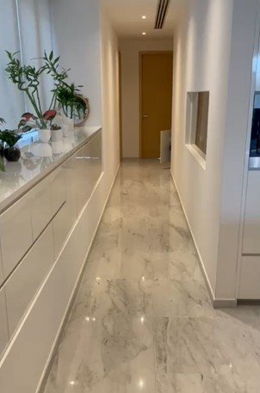
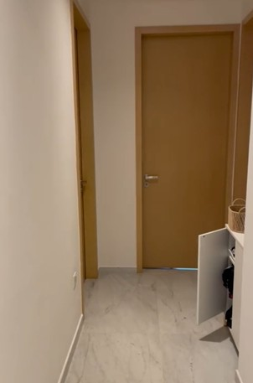
Photos
10
The cabinet will stay but the facade doors and drawers can be changed. It is W4350 x D660 x HT600mm.
The window opening to the kitchen is W1820 x HT635mm and starts 880mm HT from the floor and 760mm from the side wall,
We need to replace the cabinet. The space is W690 x D300 x HT260mm. But we will have to relocate the switches so there are accessible. It is to store sport equipment.
1
9
9
10
Please work on the lighting - ceiling & free standing lights,
Add a fan in the living room

Slide 9
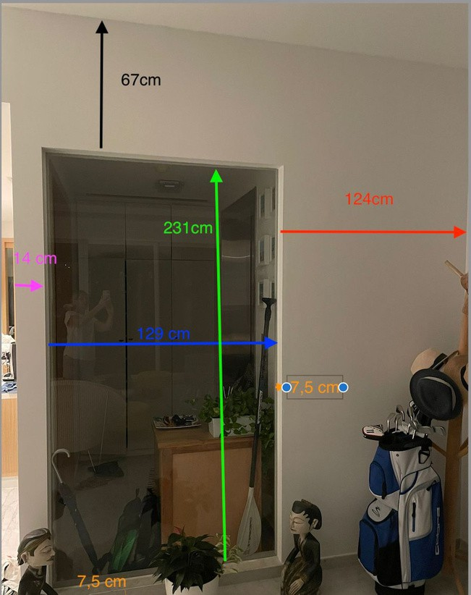
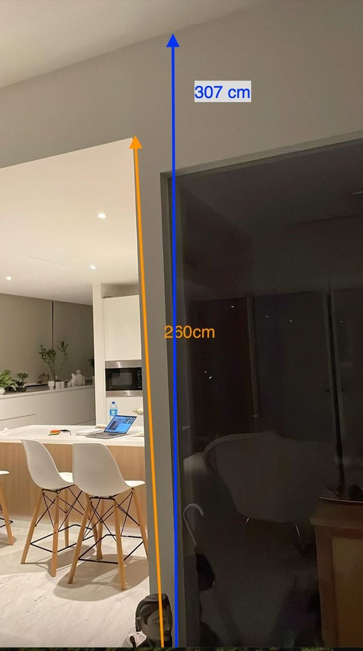
Elevation
in cm

Slide 10
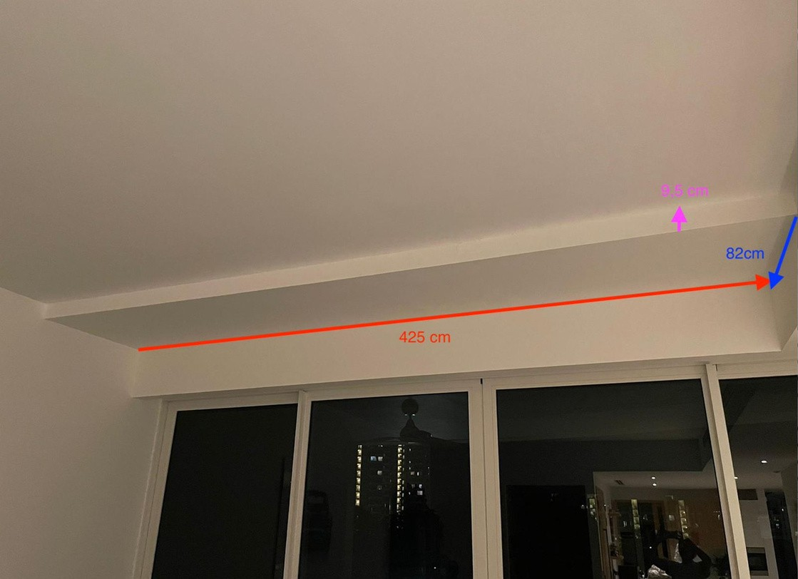
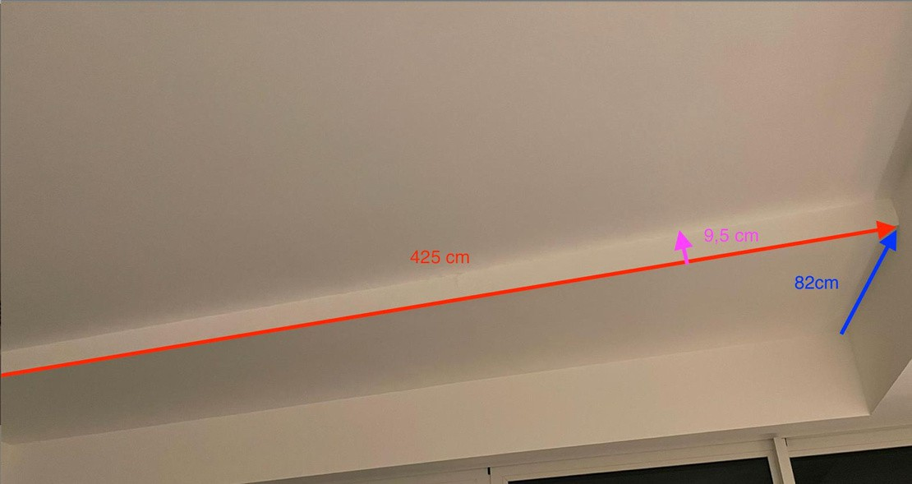
Elevation
in cm

Slide 11
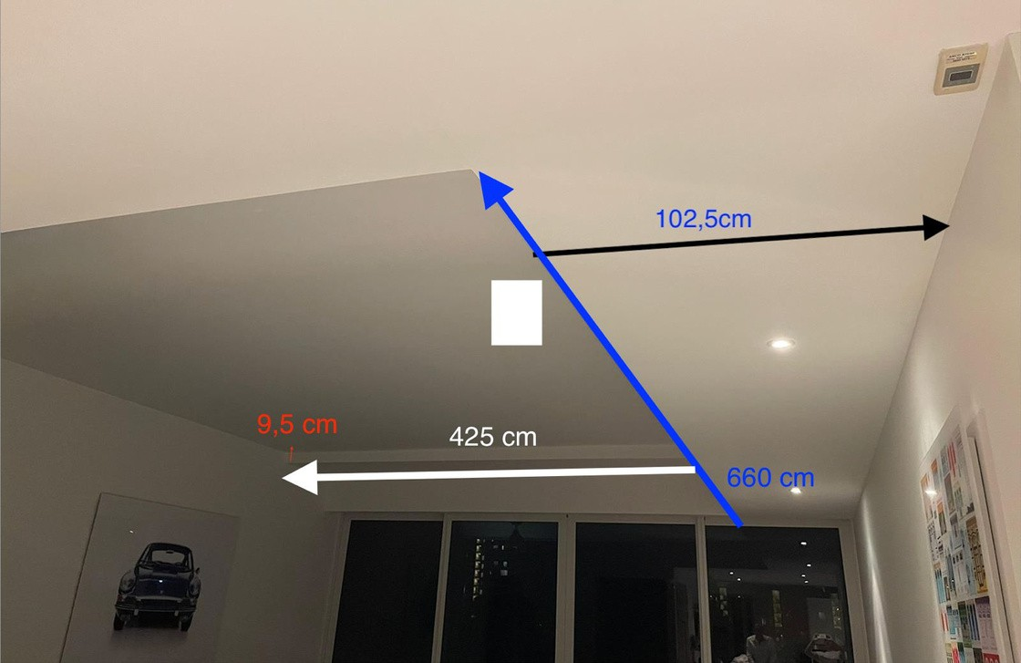
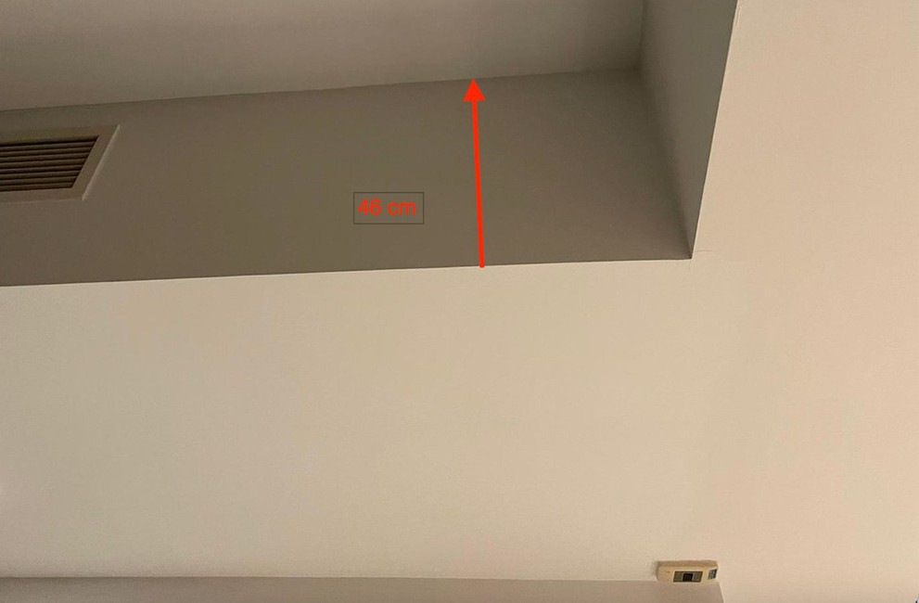
Elevation
in cm

Slide 12
Client Style
I like white spaces and very clean, so storage is important. Yet I like my place to be warm & cozy.

Slide 13
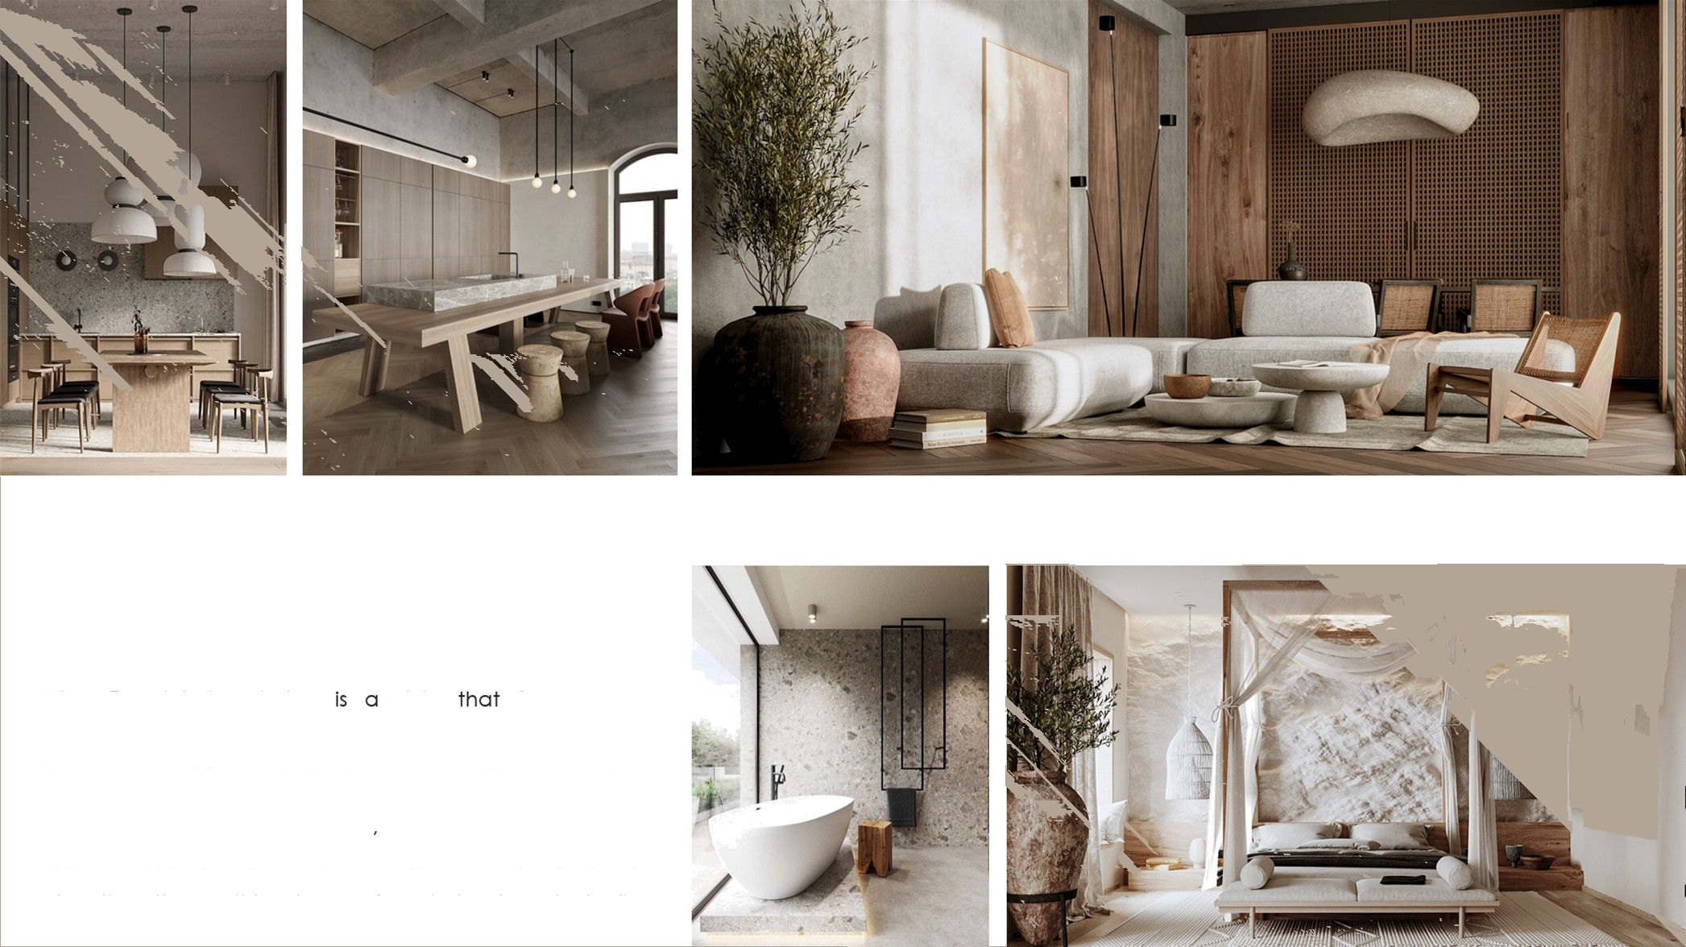







Asian Zen interior design style focuses on emphasizing a sense of harmony, balance, tranquillity. and simplicity in your home. It draws Inspiration from both the concept of Zen and the Importance of Incorporating nature Into your décor. Neutral and earthy colours are often found In Asian homes especially belges and browns. More contemporary zen styles may veer toworcls whlte and block colour schemes. Since zen is all about o ot . the soothing tones of neutral colours typically
n e

Slide 14
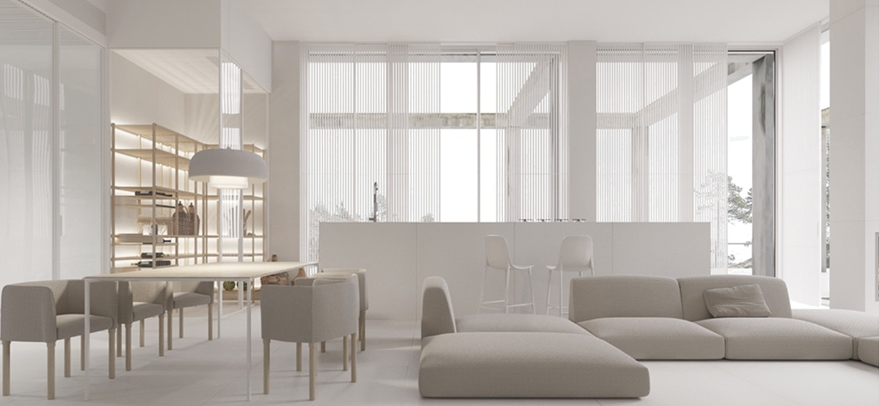
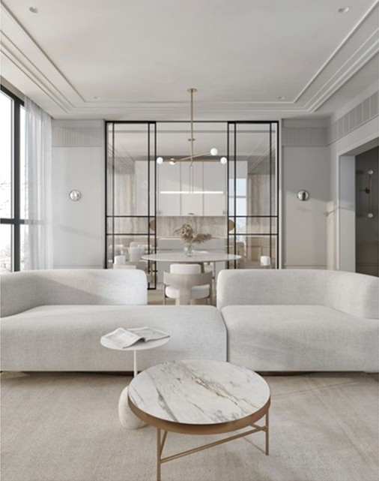
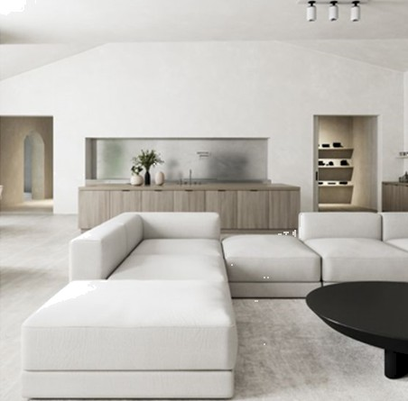
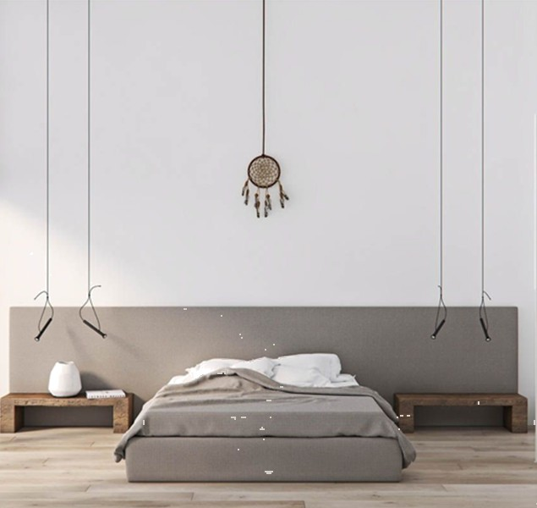
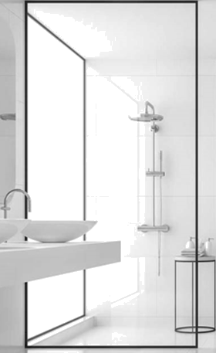










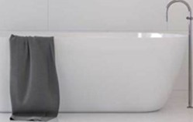

Minimalist interior design is characterized by using the base essentials to create a simple and uncluttered space. It uses simplicity, clean lines, and a monochromatic colour palette with accents in the accessories and the different textures. “Less is more" Ludwig Mies van der Rohe

Slide 15
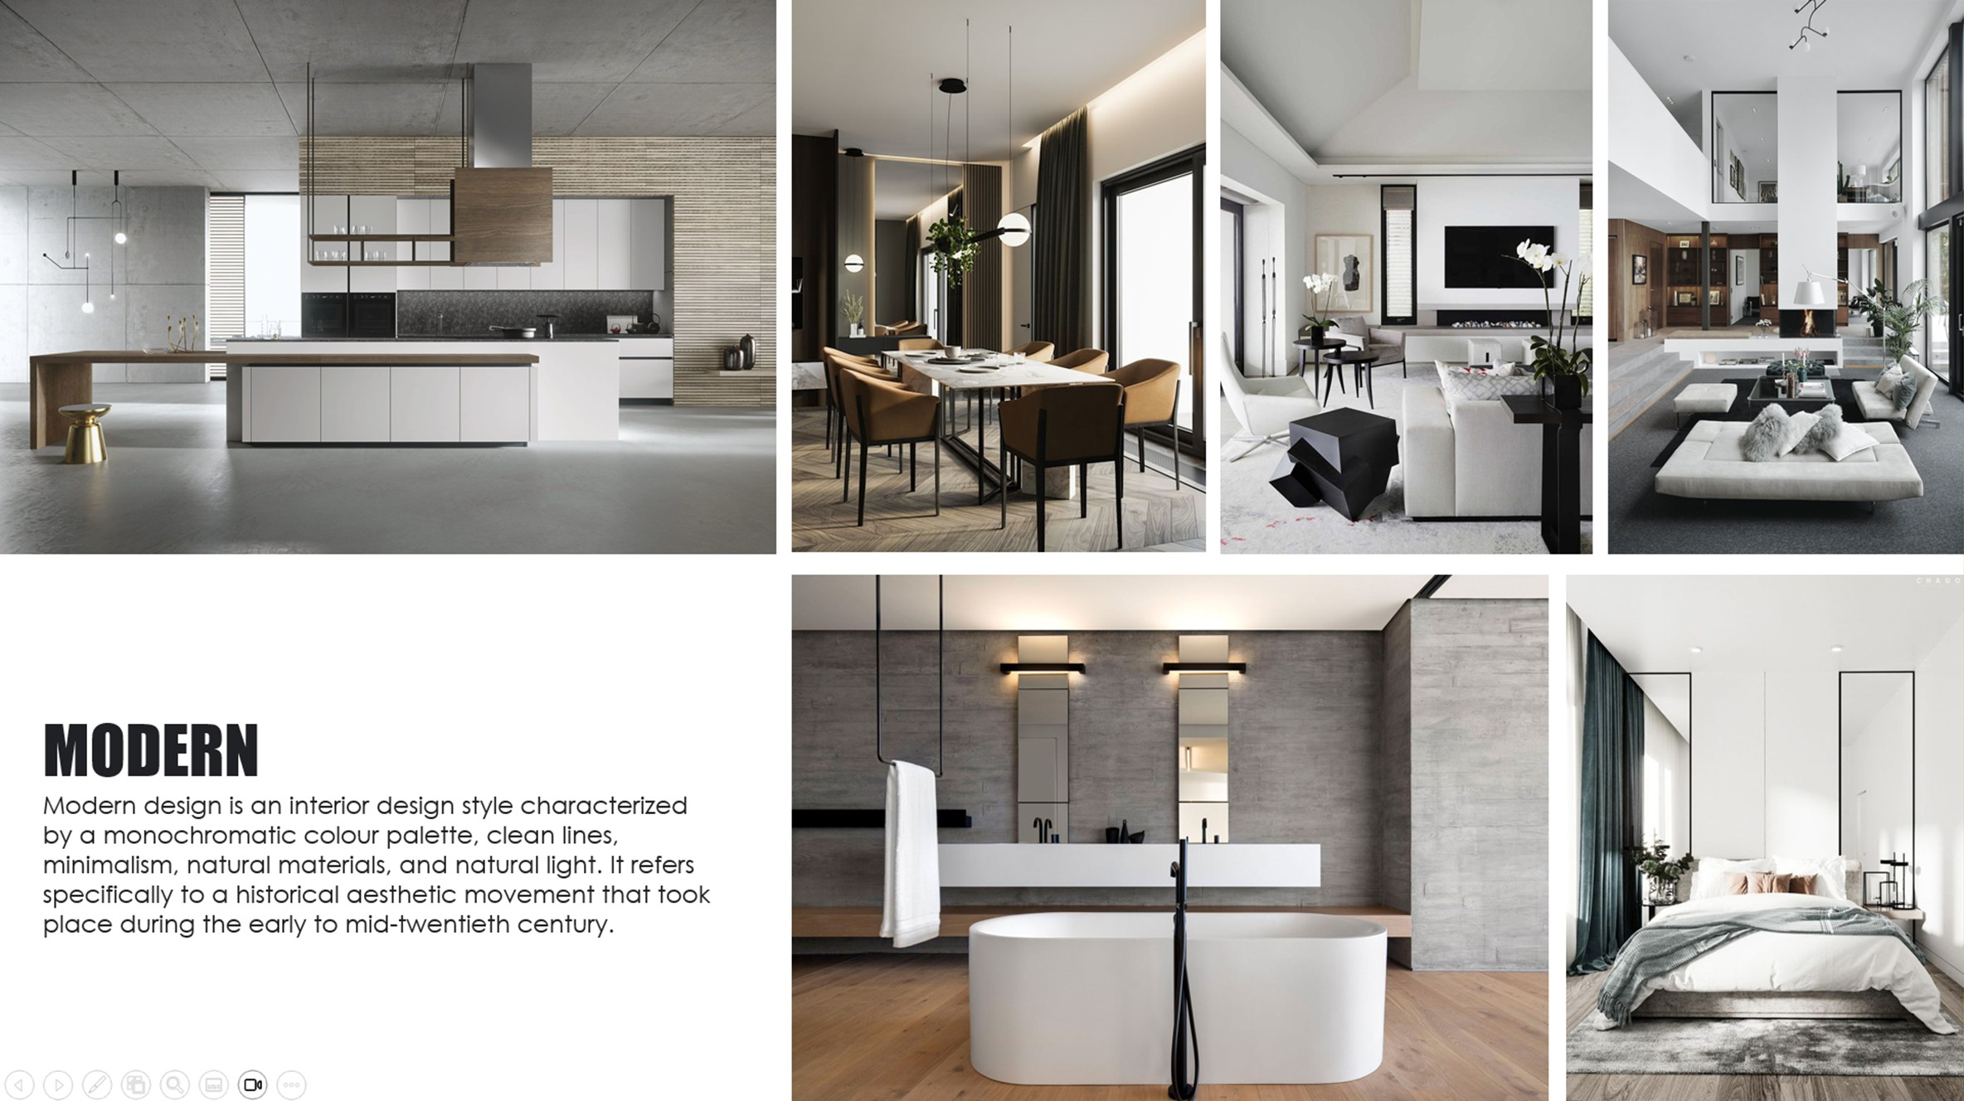

Slide 16
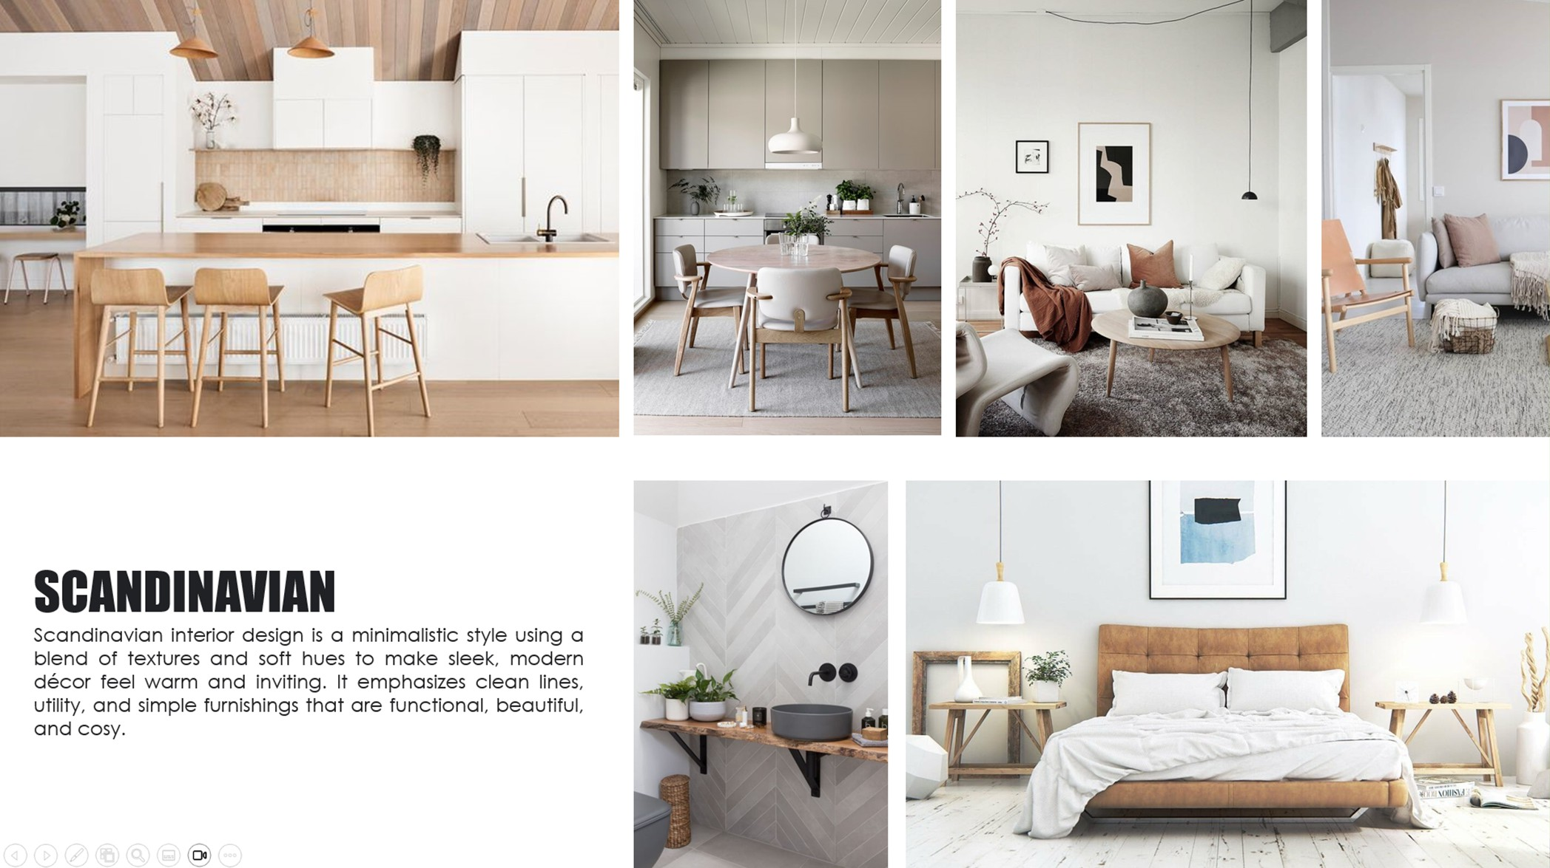

Slide 17
Furniture:
https://www.soulandtables.com.sg/ https://www.kingliving.com.sg/ https://merakidecoration. https://www.originals.com.sg/com/ https://rooma.com.sg/ https://www.islandliving.sg/ https://www.castlery.com/sg/ https://kavehome.com/en/en/
Few references for furniture
Carpet: https://irugs.com.sg/
Lighting: https://www.screed.com.sg/ https://www.lightatelier.com.sg/ https://lux-lumens.sg/
Fan:
https://fanco.com.sg/portfolio-item/huracan/ https://prismplus.sg/collections/smart-ceiling-fans https://crestarfan.com.sg/collections/all-ceiling-fans
Kitchen:
You can draw it as it is easy to custom made furniture in Singapore
Paint: https://www.benjaminmoore.sg/ https://www.farrow-ball.com/fr/
Floor: https://www.hafary.com.sg/

Slide 18
Deliverables & Schedule
Step 1
Step 2
Mentor's review
Step 3
Client's review
Zoom meeting with your mentor
1 Concept Board
1 Layout
3D perspectives
1 Concept Board
1 Layout
3D perspectives
14/11
21/11
22/11
28/11
Time varies!

Slide 19

How do you access your project board and communicate with your mentor?

Slide 20
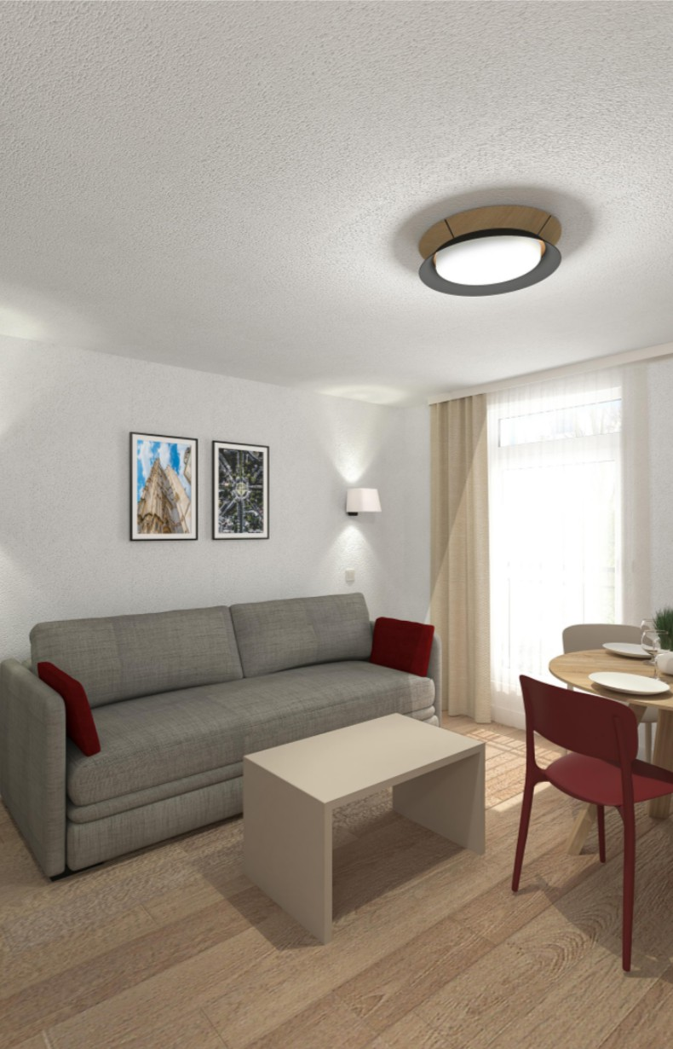
Project’s title
Your Name
Date of submission
Submission number ( ex: 1.1 - 1.2 - 2.1...)

Slide 21
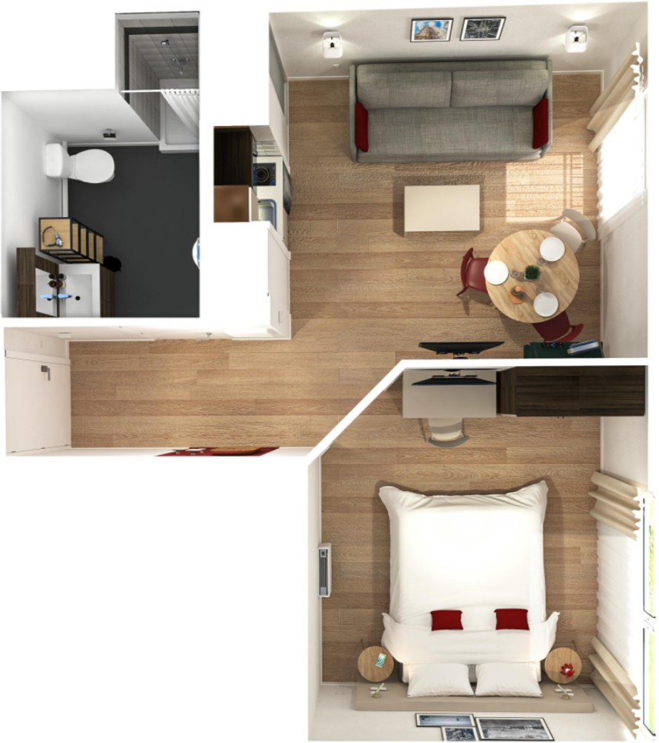
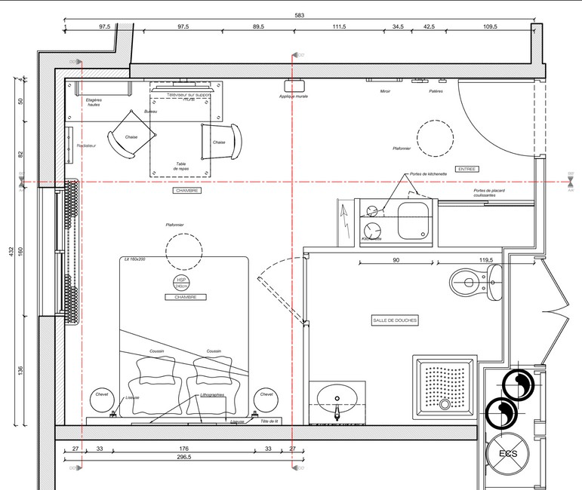
Layout
Explain your layout if needed
Need to show finishes All sizes

Slide 22
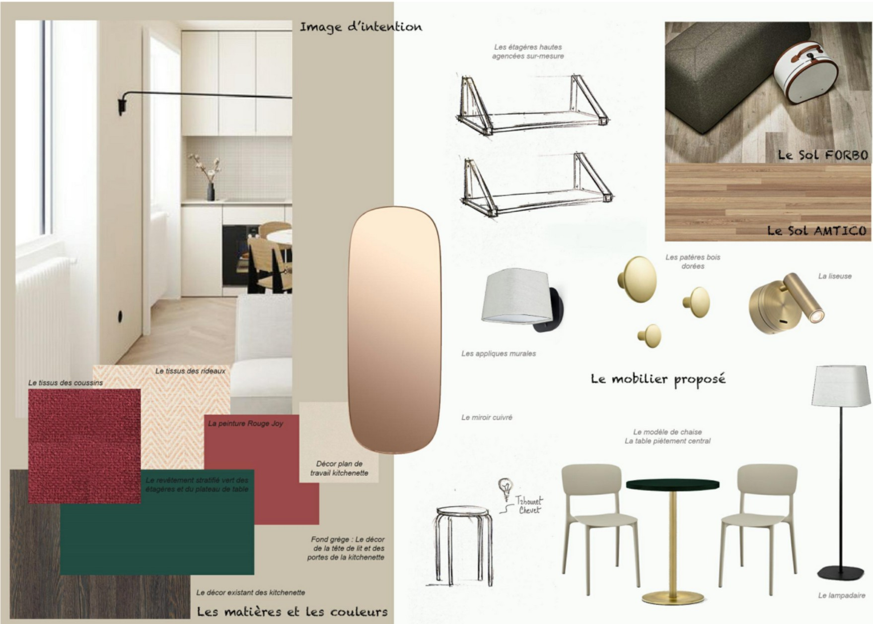
Concept Board
Can be only conceptual with explanations
or
Can combine conceptual images with your proposed furniture
or do 2 boards 1 for each

Slide 23
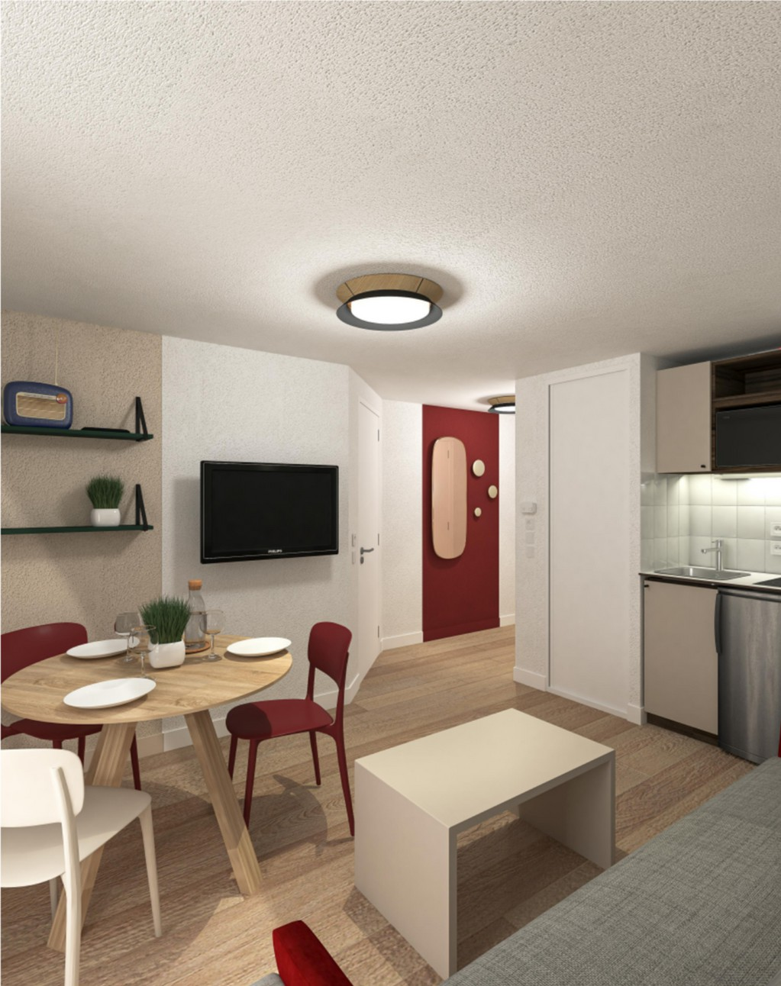
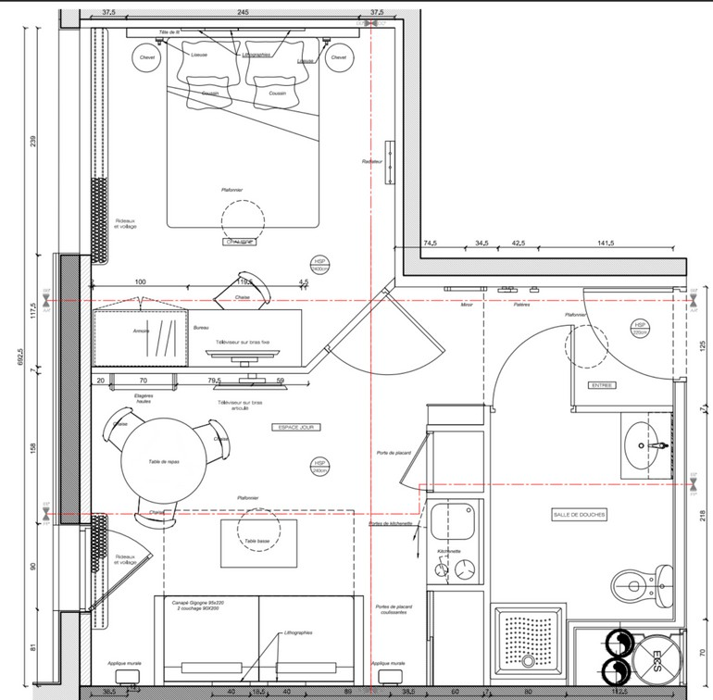
View 1
Add any comment that you think will be relevant for the client’s understanding

Slide 24
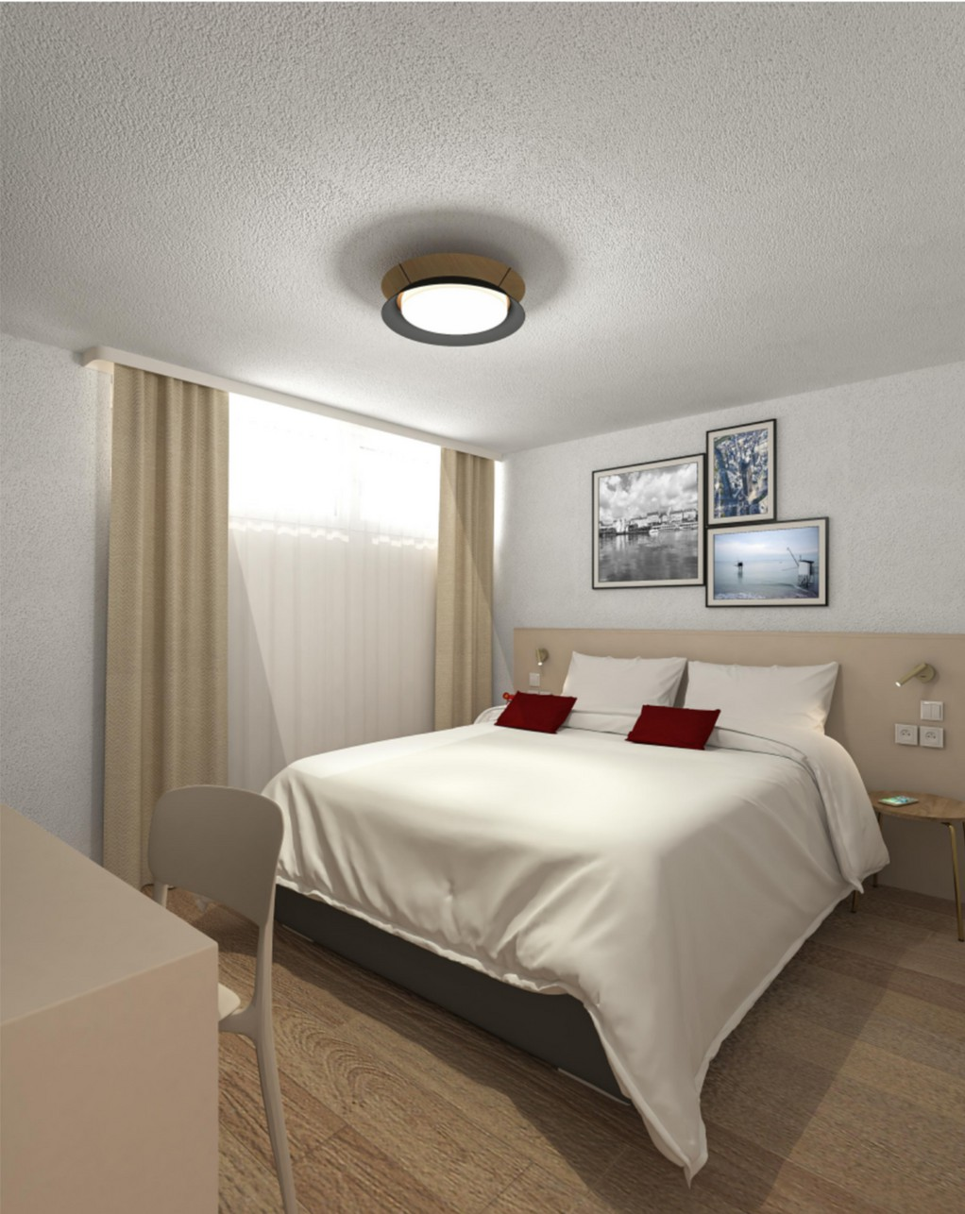
View 2
The more views the better!
RENDER 3D’s

Slide 25

only the Winner
will work on phase 3

Slide 26
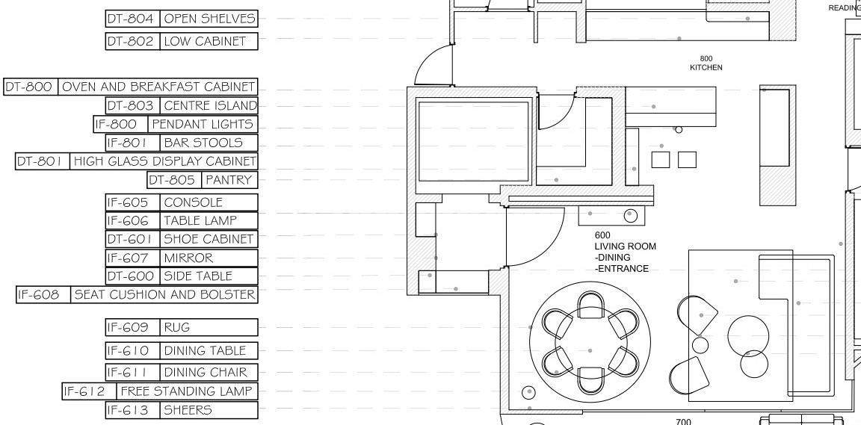
FF&E
layout

Slide 27
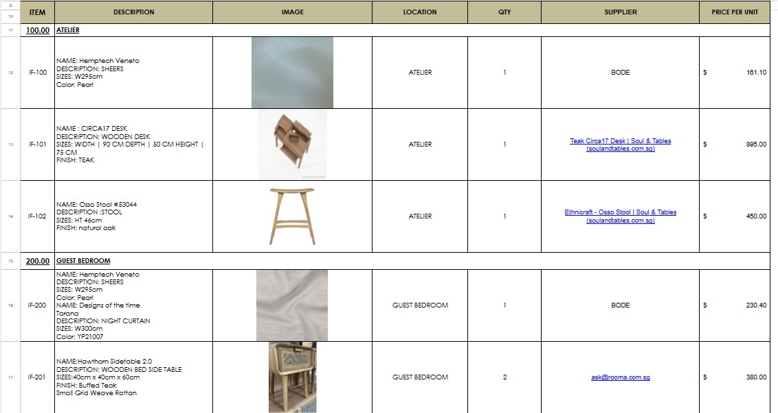
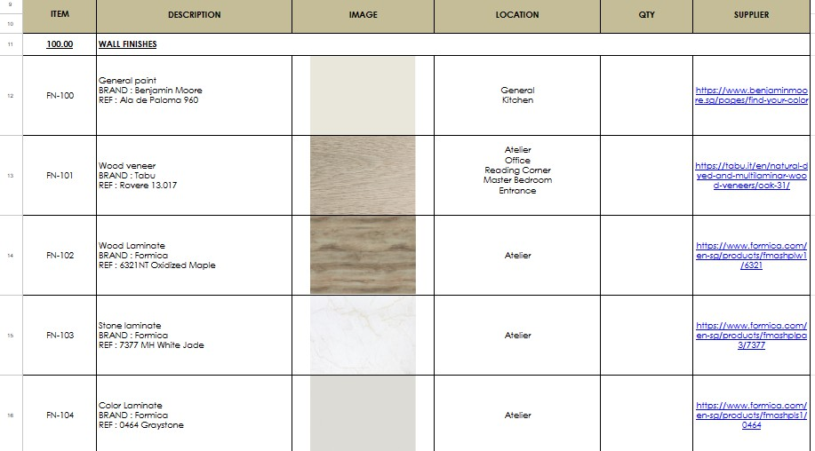
FF&E
list
All items should be listed IF - Loose Furniture
FN- Finishes
EQ - Equipment

Slide 28
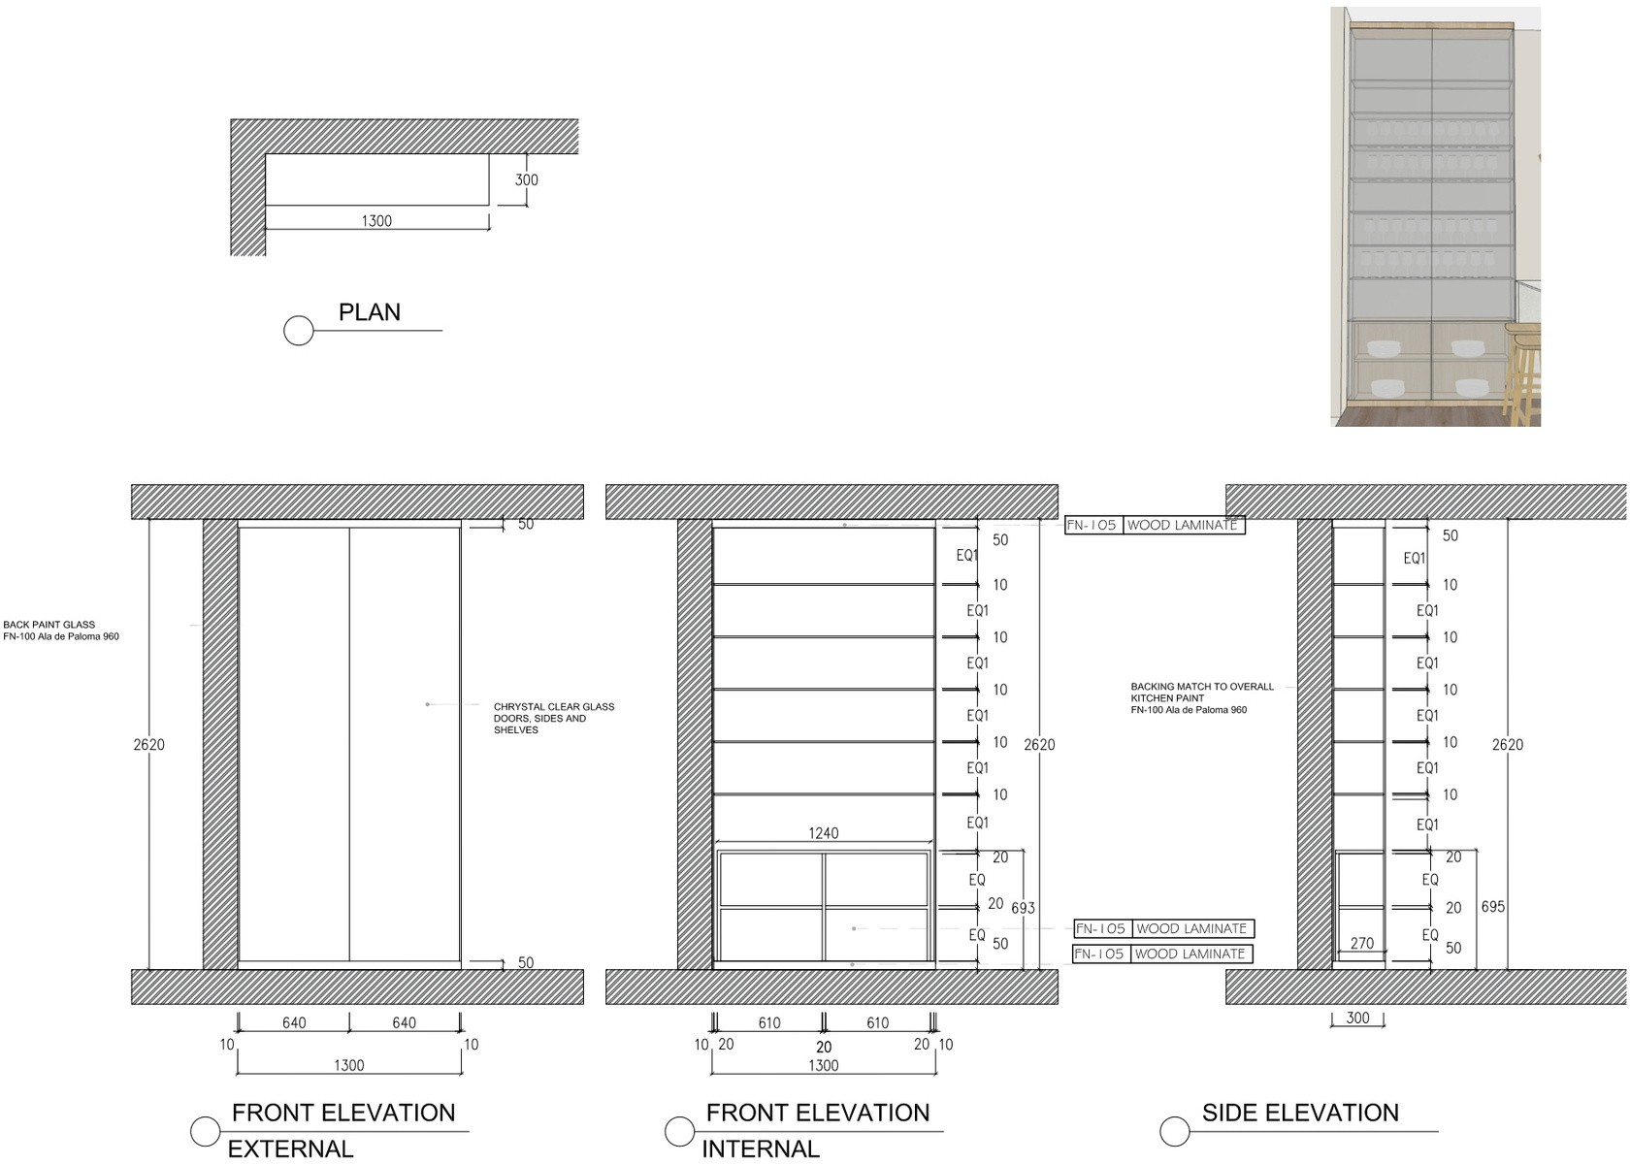
Detail

Slide 29

All the best!

